Slide 1
Matter in Our Surroundings

Slide 2
1a) Matter:
Matter is anything which occupies space and has mass.
Examples : Air, Rice, Water, Chair, etc.
Non examples : Feelings like love,
Smell, etc.

Slide 3
b) Classification of matter:
i) Early Indian philosophers classified in the form of five basic elements as air, earth, fire, sky and water called Panch Tatva.
ii) On the basis of the physical state matter is classified as solids, liquids and gases.
iii) On the basis of chemical composition matter is classified as pure substances and mixtures.
Pure substances may be elements or compounds.
Mixtures may be homogeneous mixtures or heterogeneous mixtures.

Slide 4
2) Physical nature of matter :-
i) Matter is made up of particles.
ii) The particles of matter are very tiny.
iii) The particles of matter have space between them.
iii) The particles of matter are continuously moving.
iv) The particles of matter attract each other.

Slide 5
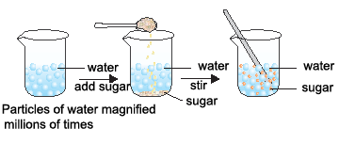
a) Matter is made up particles
Activity :- Take some water in a beaker and note its level. Dissolve some salt or sugar in it with the help of a glass rod. The salt dissolves in the water but the level of water does not change. This is because the particles of water get into the space between the particles of water. This shows that matter is made up of particles.

Slide 6
b) The particles of matter are very tiny :-
Activity :- Dissolve 2 – 3 crystals of potassium permanganate in 100ml of water in a beaker. Take 10ml of this solution and dissolve in 100ml of water. Take 10ml of this solution and dissolve in 100ml of water. Repeat this process 5 – 6 times. This shows that a few crystals of potassium permanganate can colour a large volume of water because there are millions of tiny particles in each crystal.
10ml
10ml
10ml
I00ml
100ml
100ml
100ml

Slide 7
C) The particles of matter have space between them :-
Activity :- Take some water in a beaker and note its level. Dissolve some salt or sugar in it with the help of a glass rod. The salt dissolves in the water but the level of water does not change. This is because the particles of salt get into the space between the particles of water.

Slide 8
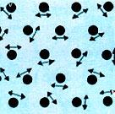
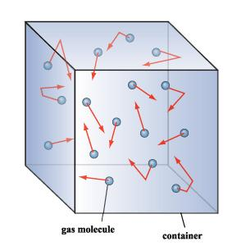
d) Particles of matter are continuously moving :-
Activity :- Take some water in a beaker and put a drop of blue or red ink slowly along the sides of the beaker. Leave it undisturbed for a few hours. The ink spreads evenly throughout the water due to the movement of the particles of water and ink.
The intermixing of two or more different types of matter on their own is called diffusion.

Slide 9
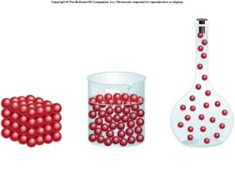
e) Particles of matter attract each other :-
Activity :- Take an iron nail, a piece of chalk and a rubber band. Try breaking them by hammering, cutting or stretching. It is more easier to break the chalk, less easier to break the rubber band and difficult to break the iron nail. This is because the particles in the iron nail are held together with greater force than in the rubber band or chalk.

Slide 10
3) States of matter
Matter exists in three different states.
They are :-
i) Solid
ii) Liquid
iii) Gas

Slide 11
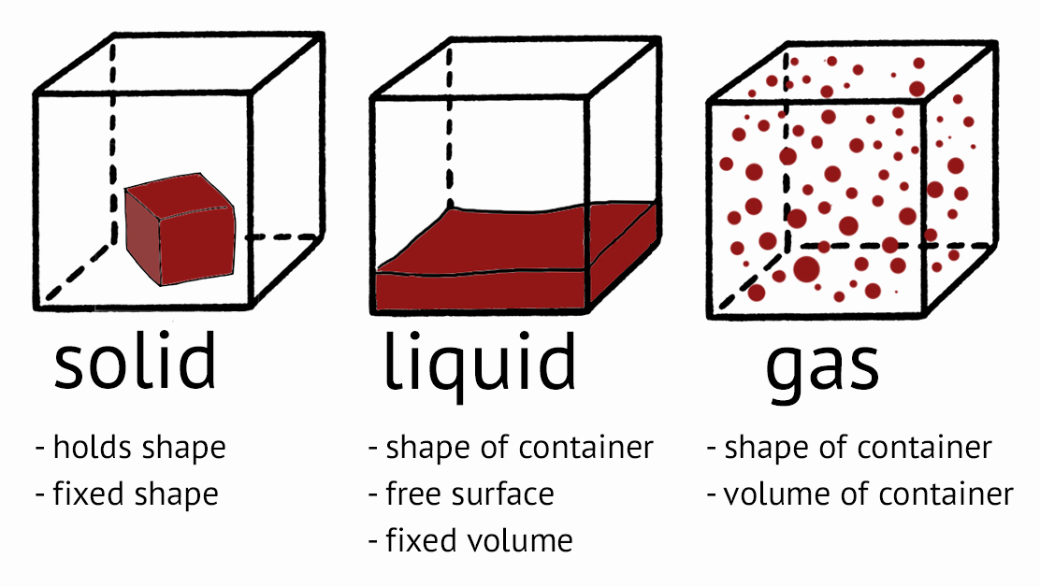
States of matter

Slide 12
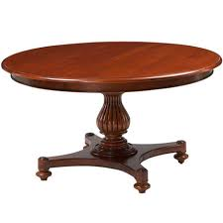
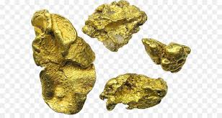
Solid
A substance is said to be solid if it possesses a definite volume and definite shape
e.g. sugar, rock , table , gold , iron etc.
In solids, the constituent particles are held very close to each other in an orderly fashion and there is not much freedom of movement .

Slide 13
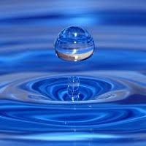
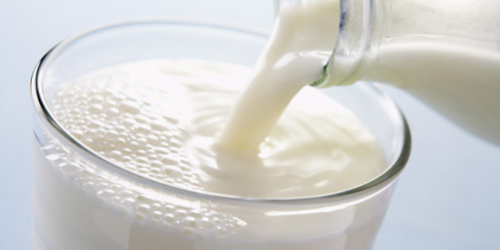
LIQUID
A substance is said to be liquid, if it possesses a definite volume but no definite shape. They take up the shape of the vessel in which they are put.
e.g. water, milk, petrol, oil, mercury, alcohol etc.
In liquids the particle are close to each other but they can move around .

Slide 14
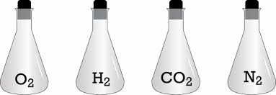
Gas
A substance is said to be a gas if it neither possesses a definite volume nor a definite shape. e.g. hydrogen, oxygen, carbon dioxide, air etc.
In gaseous matter, the particles are far apart as compared to those present in solid or liquid state and their movement is easy and fast.

Slide 15
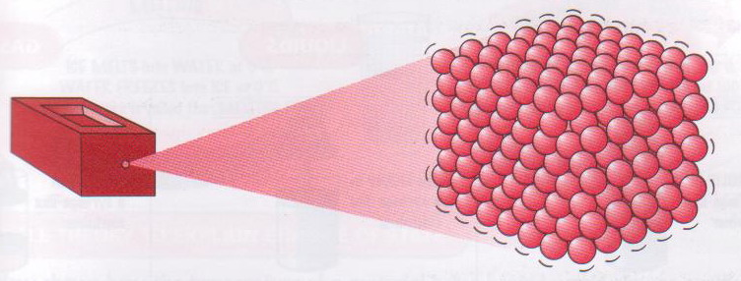
3) States of matter :-
a) Properties of solids :-
i) Solids have definite shapes and fixed volume.
ii) The space between the particle is minimum.
iii) The force of attraction between the particles is maximum.
iv) The movement of the particles is minimum.
v) They are least compressible.
vi) Their rate of diffusion is least.

Slide 16
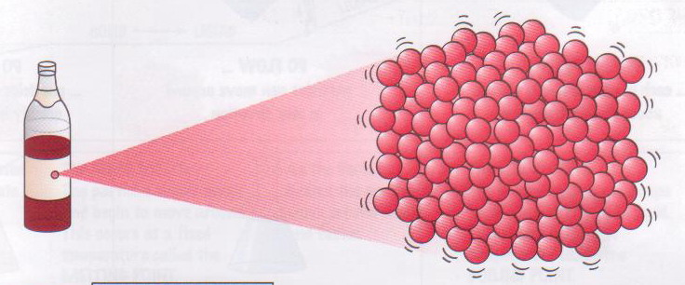
b) Properties of liquids :-
i) Liquids have no definite shape but have fixed volume. Liquids take
the shape of the container.
ii) The space between the particles is intermediade.
iii) The force of attraction between the particles is intermediate.
iv) The movement of the particles is intermediate.
v) They are less compressible.
vi) Their rate of diffusion is more than solids.

Slide 17
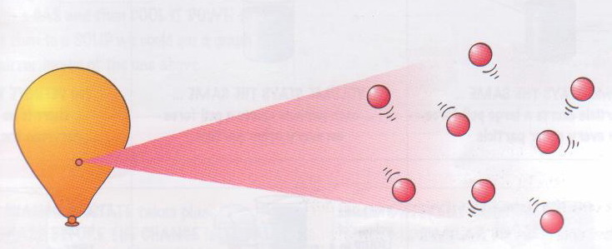
C) Properties of gases :-
i) Gases have no definite shape or fixed volume. Gases occupy the
whole space of the container.
ii) The space between the particles is maximum.
iii) The force of attraction between the particles is minimum.
iv) The movement of the particles is maximum.
v) They are most compressible.
vi) Their rate of diffusion is more than solids and liquids.

Slide 18
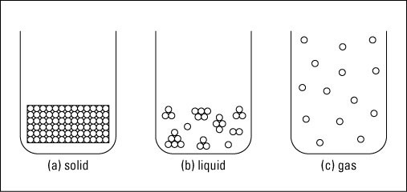
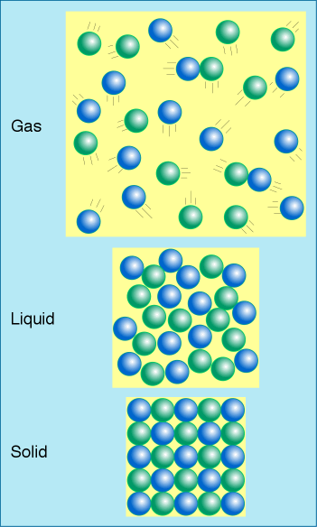
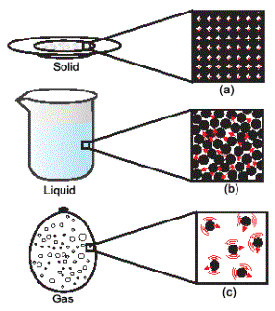

Slide 19
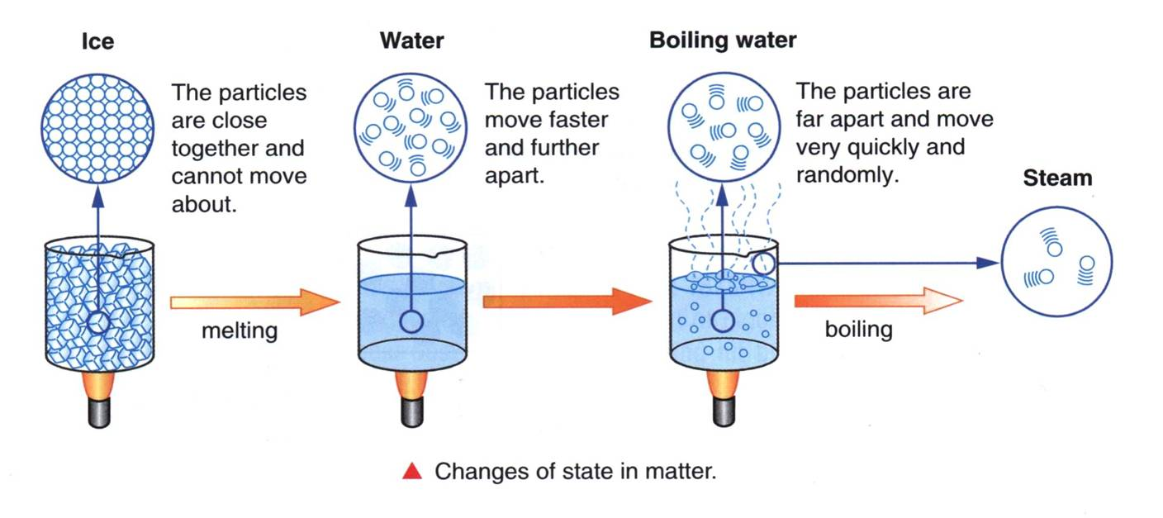
4) Change of state :-
When a solid is heated it changes into liquid. When a liquid is heated it changes into gas.
When a gas is cooled it changes to liquid. When a liquid is cooled it changes into solid.
Eg:- If ice is heated it changes into water. If water is heated it changes into steam. If steam is cooled it changes into water. If water is cooled it changes into ice.
Heat Heat
Cool Cool
Solid state
Liquid state
Gaseous state

Slide 21
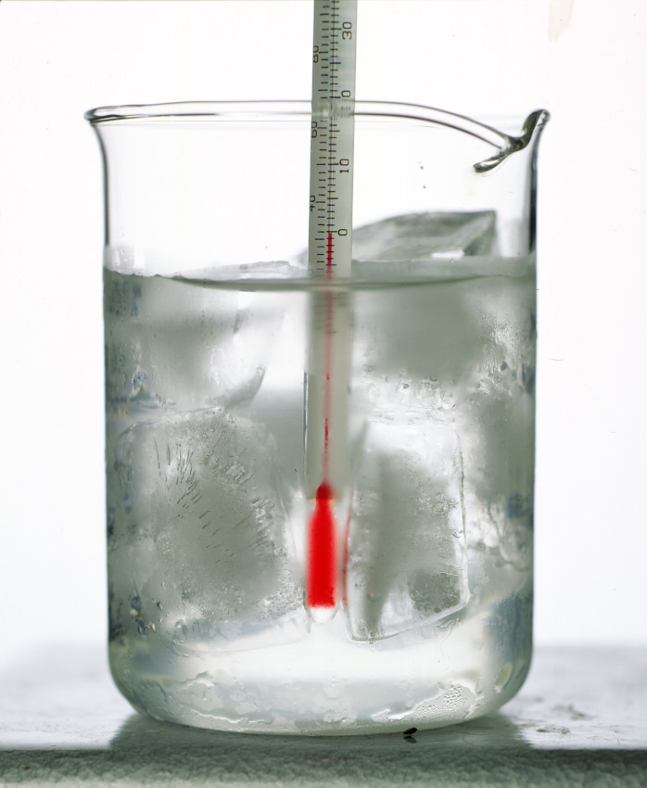
a) Melting (Fusion) :-
When a solid is heated, the particles begin to vibrate with greater speed and begin to move more freely. Then at a particular temperature the solid melts and changes into liquid. The process of melting is also known as fusion.
The temperature at which a solid melts is called its melting point. The melting point of ice is 0⁰C or 273 K.
Latent heat of fusion :-
The amount of heat energy required to change 1kg of a solid into liquid at atmospheric pressure at its melting point is called the latent heat of fusion.

Slide 22
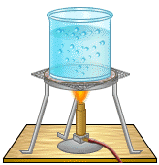
b) Boiling :-
When a liquid is heated, its particles begin to move even faster. Then at a particular temperature the liquid begins to boil and changes into gas (vapour).
Boiling is a bulk phenomenon. When a liquid boils the bulk of the liquid changes into vapour.
The temperature at which a liquid starts boiling is called its boiling point. The boiling point of water is 100⁰C or 373K ( 273 + 100).
Latent heat of vaporisation :-
The amount of heat energy required to change 1kg of a liquid into gas at atmospheric pressure at its boiling point is called the latent heat of vaporisation.

Slide 23
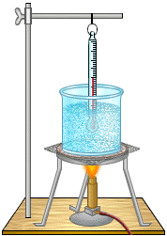
TO FIND THE BOILING POINT OF WATER

Slide 24
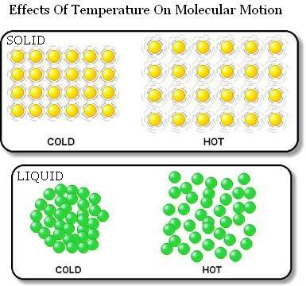

Slide 25
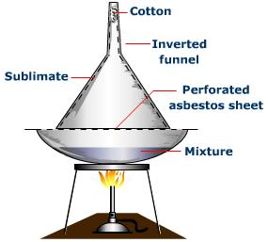
c) Sublimation :-
The change of state directly from solid to gas or from gas to solid is called sublimation.
Eg :- If solid camphor or ammonium chloride is heated, it changes into vapour. If the vapours are cooled it changes into solid.
Cotton
Inverted funnel
Ammonium chloride
solidified
Ammonium chloride
vapours
China dish
Ammonium chloride
Ammonium chloride
Burner

Slide 26
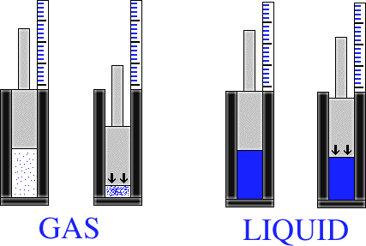
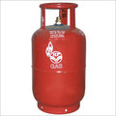
d) Effect of pressure on gases :-
When pressure is applied on gas the particles come closer and the gas changes into liquid.
We can liquefy gases by applying pressure and reducing the temperature.
Compressed solid carbon dioxide is called dry ice. If the pressure is reduced it changes directly to gas without coming into liquid state. So solid carbon dioxide is known as dry ice.

Slide 27
5) Interconversion of the three states of matter :-
The states of matter are inter convertible. The state of matter can be changed by changing the temperature or pressure.
Solid
Sublimation
Fusion
Sublimation
Solidification
Vaporisation
Gas
Liquid
Condensation

Slide 28
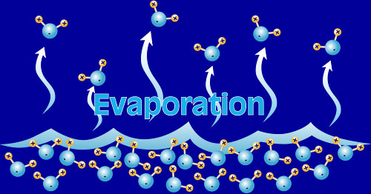
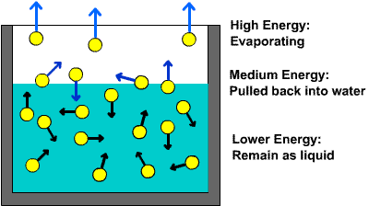
6a) Evaporation :-
The change of a liquid into vapour at any temperature below its boiling point is called evaporation.
Evaporation is a surface phenomenon. Particles from the surface gain enough energy to overcome the forces of attraction and changes to vapour state.
b) Factors affecting evaporation :-
The rate of evaporation depends upon surface area, temperature,
humidity and wind speed.
Increase in the surface area increases the rate of evaporation.
Increase in temperature increases the rate of evaporation.
Increase in humidity decreases the rate of evaporation.
Increase in wind speed increases the rate of evaporation.

Slide 31
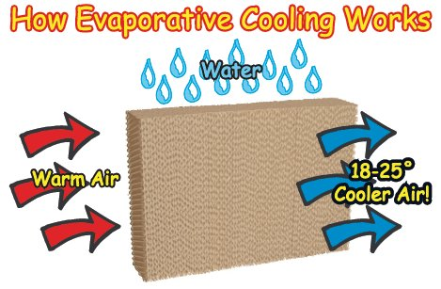
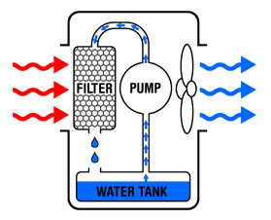
c) Evaporation causes cooling :-
When a liquid evaporates, the particles of the liquid absorb heat from the surroundings and evaporates. So the surroundings become cold.
Eg :- People sprinkle water on the roof or open ground because during evaporation water absorbs heat makes the hot surface cool.
During summer we sweat more because during evaporation the sweat absorbs heat from our body making the body cool.
Wearing cotton clothes in summer keeps us cool because cotton absorbs sweat and when the sweat evaporates it absorbs heat from our body making the body cool.

